Slide 1
Production Engineering
Course 2: Architecture

Slide 2

Building a house
Complex process
Requires coordination
Various participants across the project lifecycle
Shared trait is architecture
Notes:
Let's imagine for a minute that we're part of a real estate construction company.
Building houses is a complex process that requires coordination between multiple entities and personas.
Participants in the process can have different roles and are accountable for various deliverables or processes:
end customers / beneficiaries
local authorities
construction manager
construction workers
plumbers
electricians
Different types of houses serve different needs.
Unplanned items or faulty deliverables can have undesired consequences on the end goal or timeline.
The shared liaison is the architecture.

Slide 3
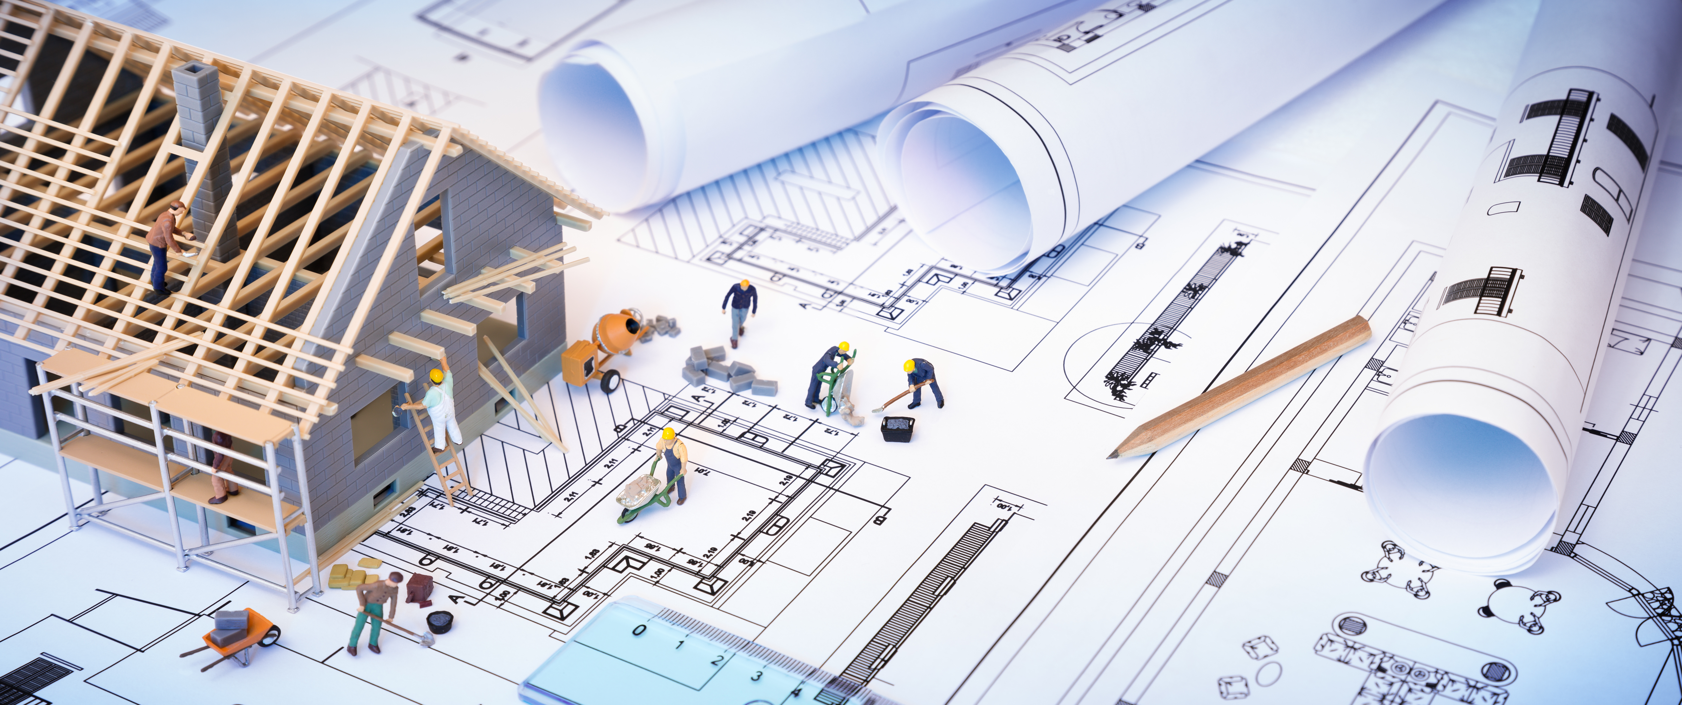
Building a house, continued
High-level design choices
Technical standards
Many skills
Notes:
A software architect makes high-level design choices and frames technical standards. This might include tools, software coding standards, or platforms to be used.
To be effective, a software architect needs broad and deep technical knowledge to make good decisions. He/she will provide a complete technical support of the project from the inception through planning to construction.
Skills:
Broad technical knowledge
Responsibility
Communication
Analytical

Slide 4
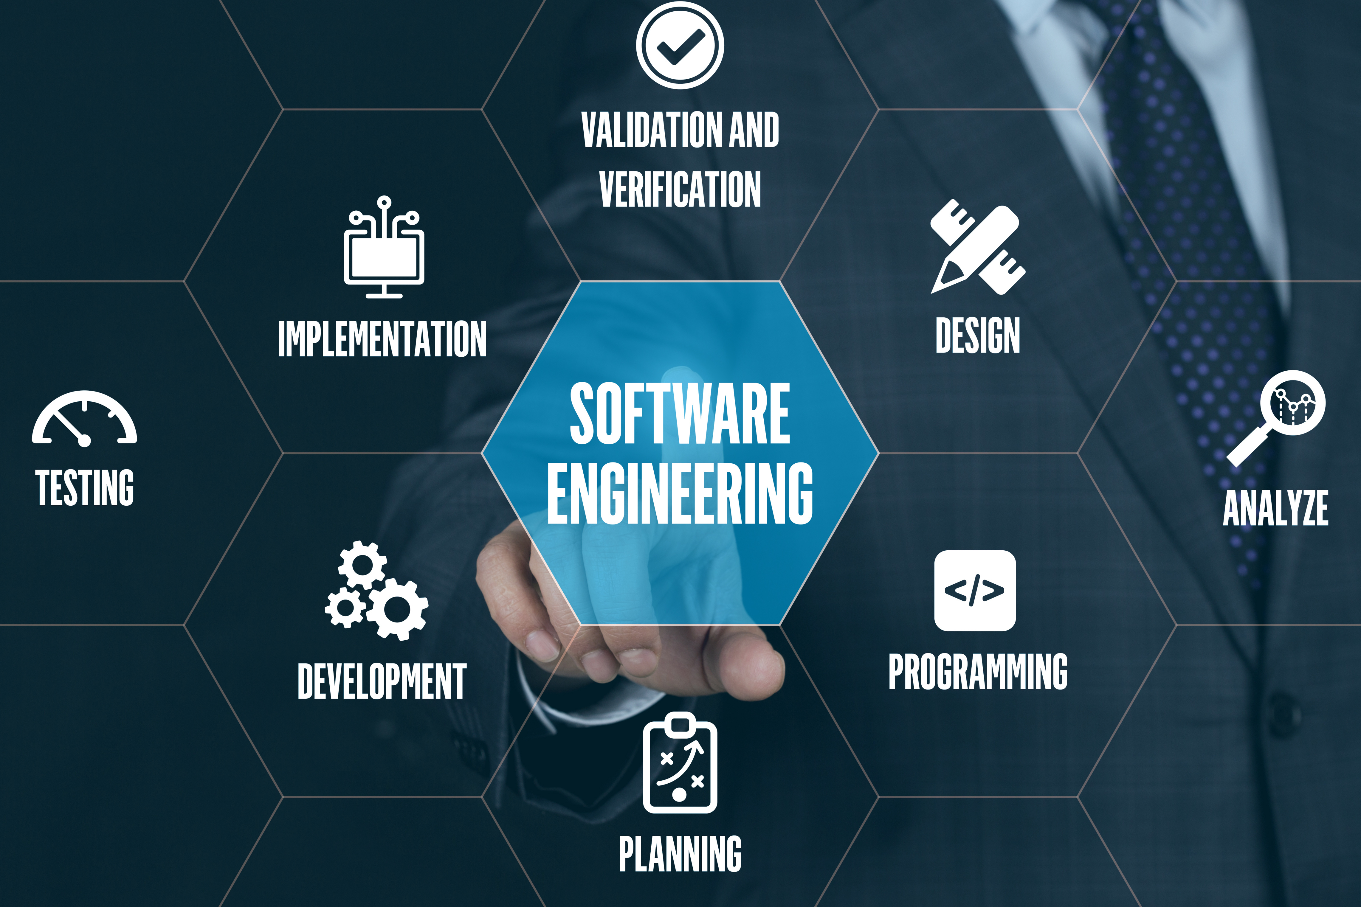
On deciding about architecture, infrastructure & technologies
Understand requirements
SLA is king
Master the existing ecosystem
Use well-defined criteria for technology choices
Consider costs
Plan for post-release
Notes:
Software engineering is not just about coding... In a sense, it has a lot of commonality with building a house (a long-lived product).
When designing the architecture / choosing technologies
understand what is the problem you are trying to solve
That will most of the time mean that you need to familiarize yourself with the business and become a domain expert (confined to the project scope)
SLA is king (more on Lecture 9), so are customer expectations - you better start from that, as it has huge implications on your architecture
take existing systems into account (the current status quo)
take existing team knowledge into account (expertise)
take the maturity of the technologies into account (is it battle tested, at scale?)
evaluate the fitness of that technology for your use case
is there a strong community revolving around that technology? (open source? vendor support?)
evaluate COGS (Cost of Goods Sold)
consider business continuity and disaster recovery (envision pitfalls, what are the consequences?)

Slide 5
Software projects
70%
£100M
$97M
Of large projects fail or are challenged
Wasted by BBC on a failed video archives system
Average waste for every $1B invested due to project performance
29%
41%
Of projects succeed within time, budget & requirements
AWS holds 41.5% of the cloud computing market.
Notes:
Despite larger projects being more prone to encountering challenges or failing altogether, even the smallest of software projects fail one in ten times.

Slide 6
Weeks of programming can save hours of planning
Meetings will continue until software is delivered

Slide 7


How to drive a successful architecture
Goals
Requirements
High-level design (HLD)
Low-level design (LLD)
Security considerations
Rollout plan
Operational aspects
Data governance / migration / lifecycle

Slide 8

Goals
Objectives
Key results – How do we get there ?
Specific
Measurable
Achievable
Realistic
Time-bound
Notes:
Gather & document the objectives of the project. What is the problem that you are solving? What are you trying to improve? Objectives should be significant, concrete, action-oriented, and (ideally) inspirational.
Objectives should be linked to customer needs or pain points. Each objective should be associated with one or multiple key results. Key results benchmark and monitor how we get to an objective. Effective KRs are specific and time-bound and aggressive yet realistic. Most of all, they are measurable and verifiable.

Slide 9
I will fix the website for most people as measured by 7 out of 10 people being able to get through, a 1 second response time, and a 1% error rate.

Slide 10
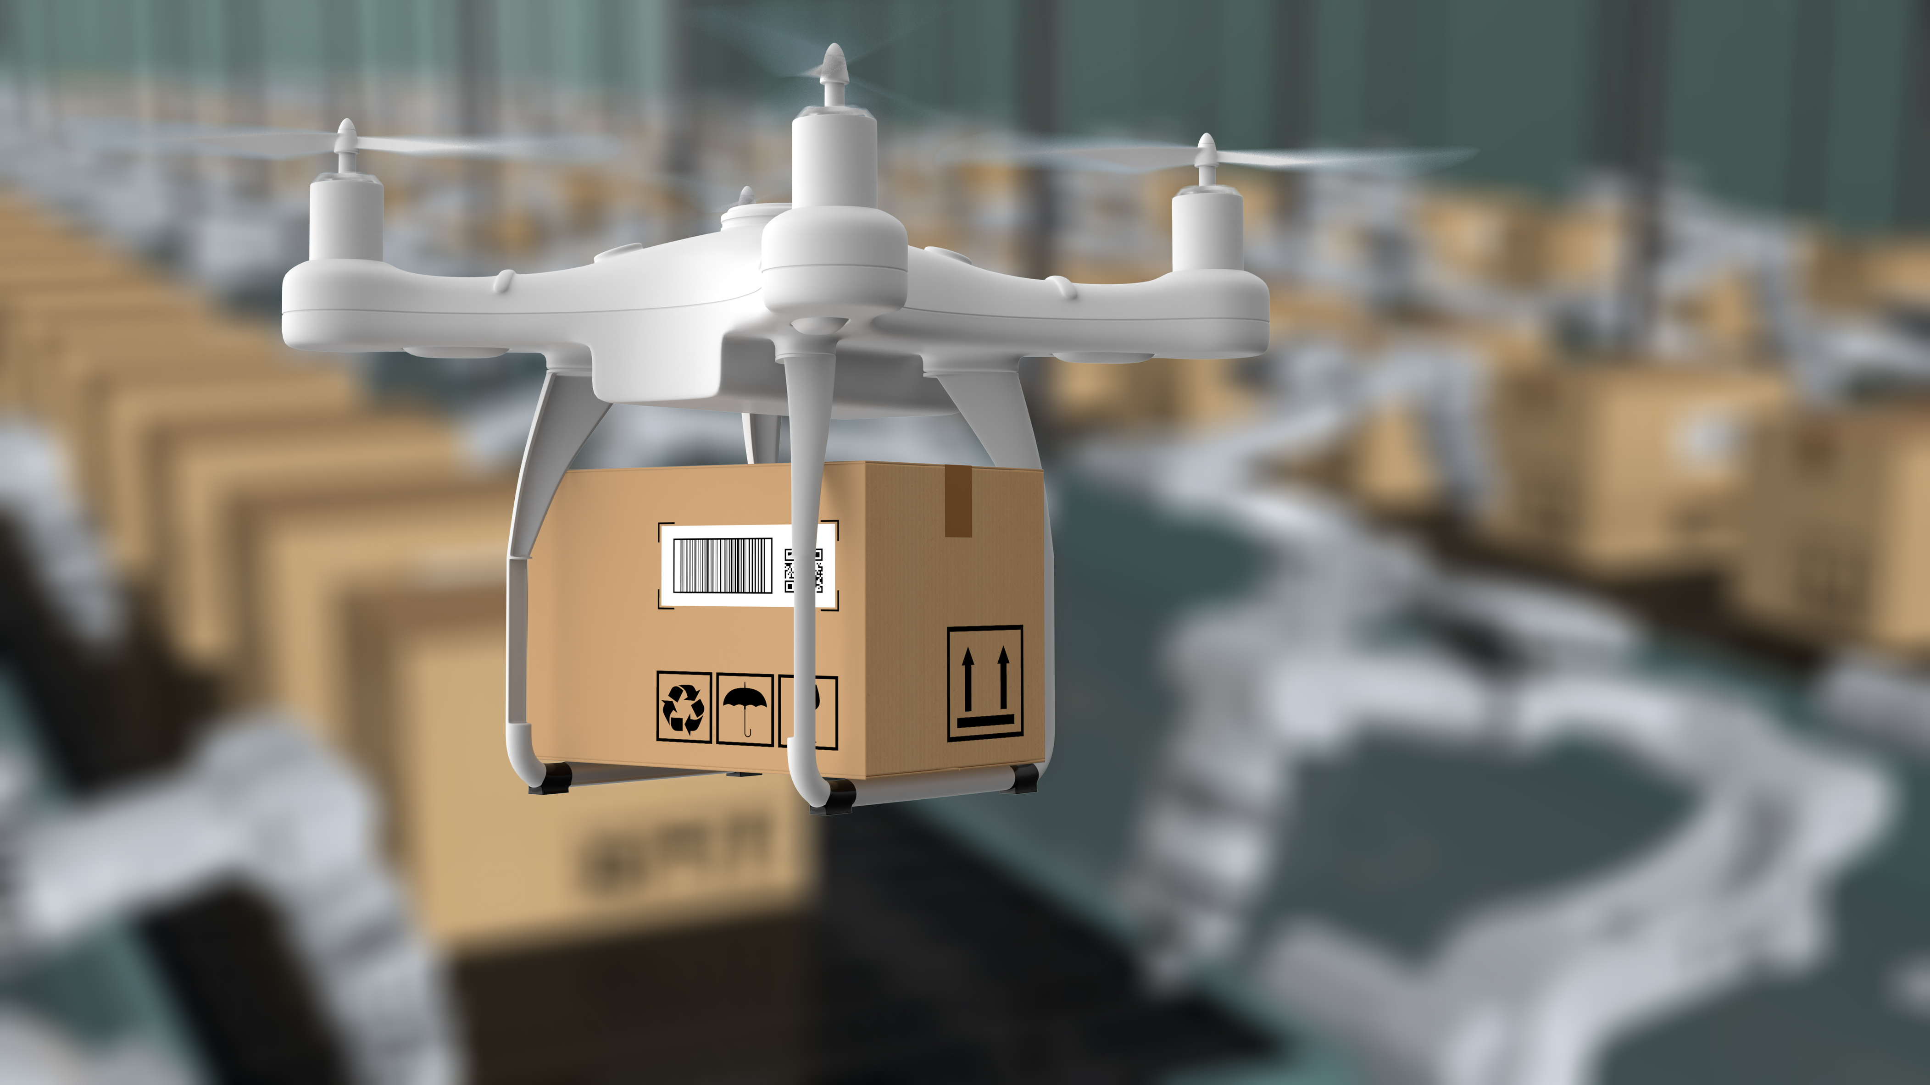
Requirements
User needs
Assumptions and dependencies
Functional & non-functional
Close to OKRs
Notes:
Requirements should describe what the software will do (functionality), how it is expected to perform.
Requirements have to be linked as close as possible to OKRs / customer requests (that is, have some justification and show the thought process behind the requirements). Or, conversely, if they are still in flux, and there’s no other place for them add them here.
Requirements may be captured in different forms:
functional and non-functional requirements
use cases
user stories & epics
Requirements should also contain minimal go to market information: What is the projected initial traffic and what latency is required? When do we need this to go live? What percent uptime is expected?
Sometimes this might not be known upfront, yet companies may have internal standards. For instance, in Adobe all user facing services have a minimum of 99.9%. This standard works as a good starting point.

Slide 11
Provide means for the user to browse the list of new movies (movies added in the past week).
The movies list page should load within 2 seconds in 99% of the time.
Prevent a user to access another user’s account.

Slide 12

High-level design
Overview of the entire system
Describes domain model
Identifies major components
Identifies main workflows
Notes:
A high-level description of the system. Describe at a high level how the system will work. Don't get bogged down with details, those belong in a low-level design.
A diagram showing how the major components communicate is very useful. If this system is intended to be a component in a larger system, a diagram showing how it fits into the larger system is useful.

Slide 13
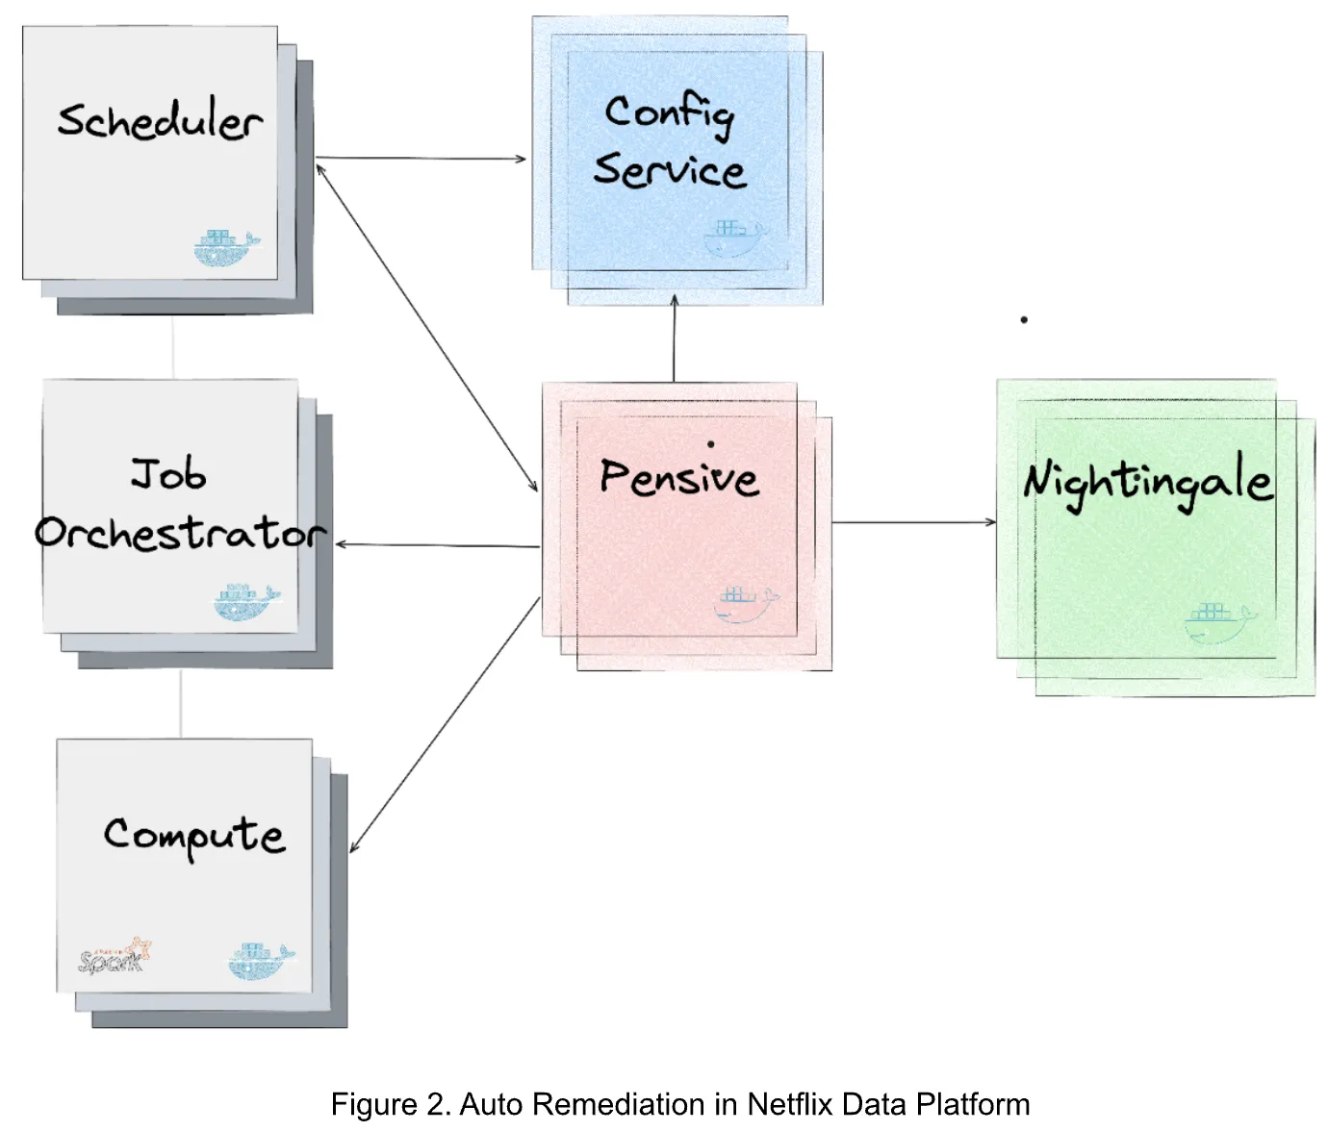
Source: Evolving from Rule-based Classifier: Machine Learning Powered Auto Remediation in Netflix Data Platform
Notes:
This is a kind of data flow diagram, but there are many other kinds of diagrams. Choose the most appropriate one for conveying various aspects of the HLD.
Just google ‘netflix high level design diagram’ and you’ll get a bunch of diagrams, each with its own definition of “high level” and concerning a different part of the Netflix business
https://medium.com/@narengowda/netflix-system-design-dbec30fede8d

Slide 14

Low-level design
Next level of detail
Describes each component
Documents
APIs
Protocols
Formats
Database schema
Notes:
The low-level design is an iteration of detail based on the high-level design. It contains detailed descriptions of every component in the system, what changes, what’s new, as well as the functionality it exposes.
A low-level design will document things like APIs, communication protocols, file formats, database schema, etc.

Slide 15
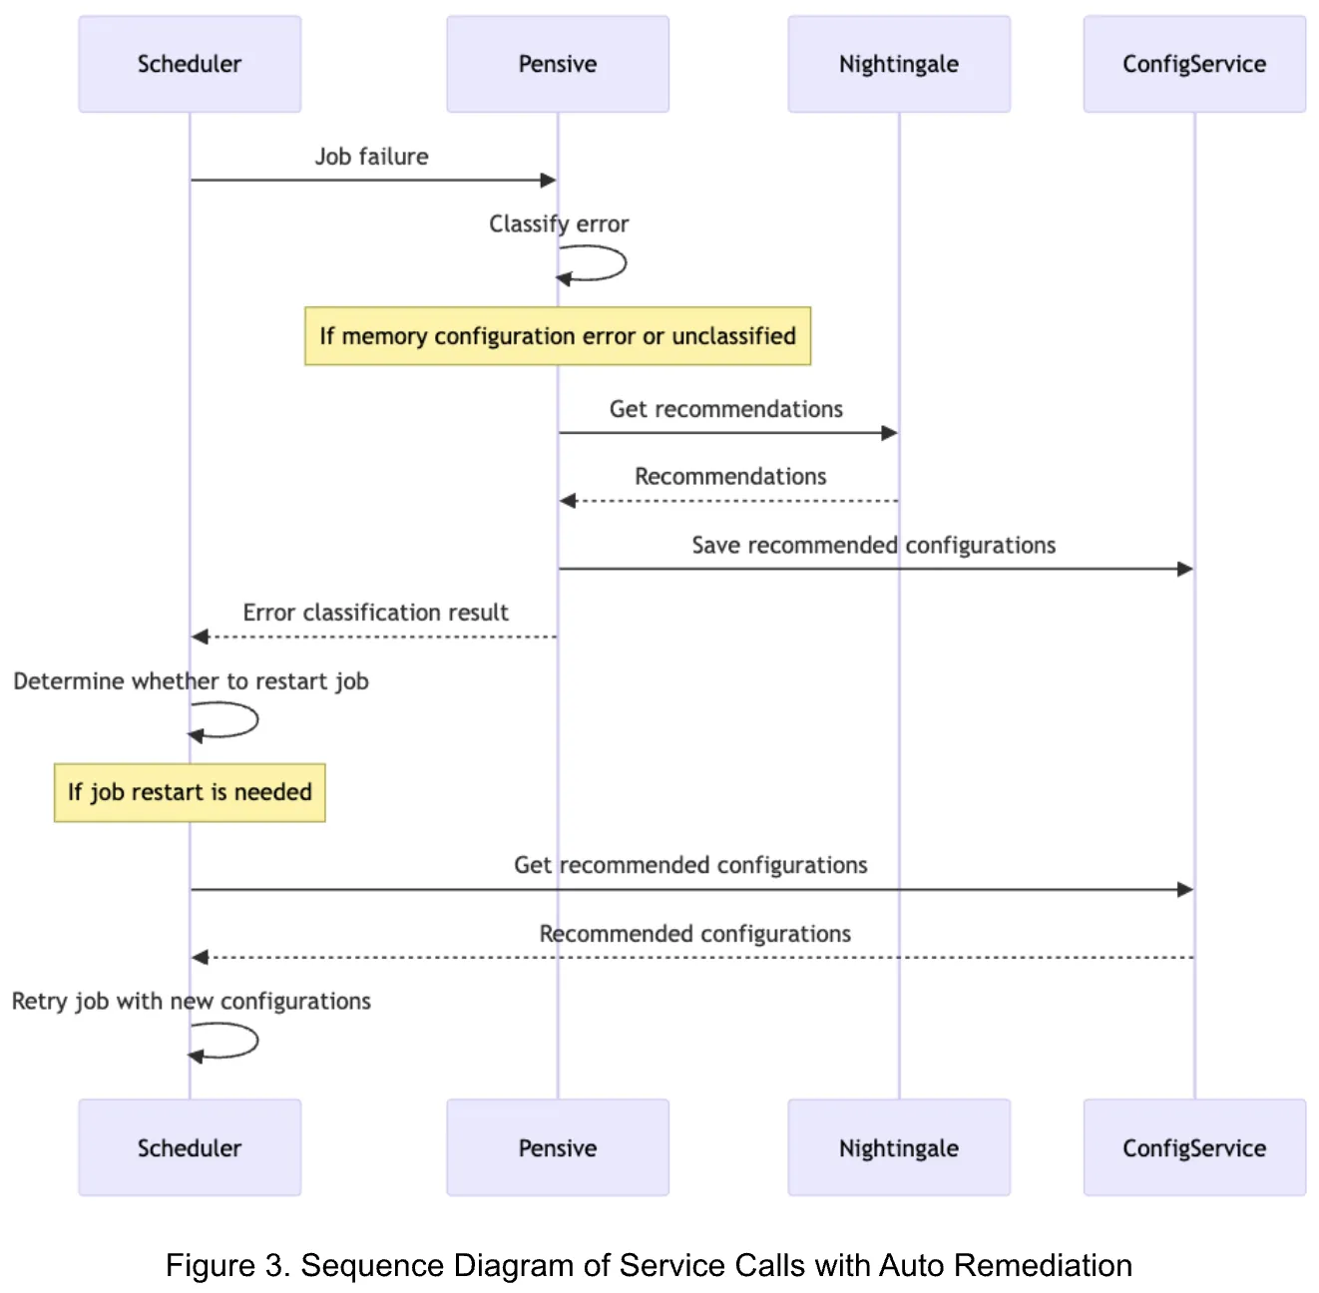
Source: Evolving from Rule-based Classifier: Machine Learning Powered Auto Remediation in Netflix Data Platform

Slide 16

How to drive a successful architecture
A balance between software aspects
Complexity vs. reliability
Feature set vs. maintainability
Agility vs. security
Notes:
"Architecture is the stuff you can’t Google."
"There are no right or wrong answers in architecture—only trade-offs."
"Why is more important than how."
Designing software systems is challenging, as you must find balance between various aspects.
Simplicity
Scalability
Performance
Reliability
Generality
1. Features
2. Maintainability
3. Extensibility
Stability vs agility
Security

Slide 17
Laws of Software Architecture
Everything in software architecture is a trade-off.
Why is more important than how.
Notes:
Source: https://learning.oreilly.com/library/view/fundamentals-of-software/9781492043447/ch01.html#idm45838975795424

Slide 18

Debate: Trade-offs (interactive)
There are no binary choices, only trade-offs
Understand trade-offs and make conscious decisions
Let's debate:
Cloud vs. Datacenter
Java vs. Python vs C
Managed cloud services vs. on-prem self-managed services
MySQL (RDBMS) vs. MongoDB (document DB)
Horizonal vs. vertical scaling
CAP considerations

Slide 19
You get better at making decisions by considering tradeoffs, as you understand various architectures and technologies in depth, learning about use cases, advantages and disadvantages, and operational pitfalls.

Slide 20

The domain model
A set of abstractions that describes a domain of knowledge and activity
Typically, simpler than reality
Uses natural language
Non-technical
Notes:
Data modelling is a process that defines and analyzes data requirements needed to support business flows. The requirements are initially described as a conceptual data model – the domain model.
A domain model is a formal representation of a knowledge domain with concepts, roles, datatypes, actors, and rules. It is a system of abstractions that describes selected aspects of a sphere of knowledge, influence or activity. The domain model is a representation of meaningful real-world concepts pertinent to the domain that need to be modelled in software. The concepts include the data involved in the business and rules the business uses in relation to that data. A domain model leverages natural language of the domain.
A domain model generally uses the vocabulary of the domain, thus allowing a representation of the model to be communicated to non-technical stakeholders. It should not refer to any technical implementations such as databases or software components that are being designed.

Slide 21
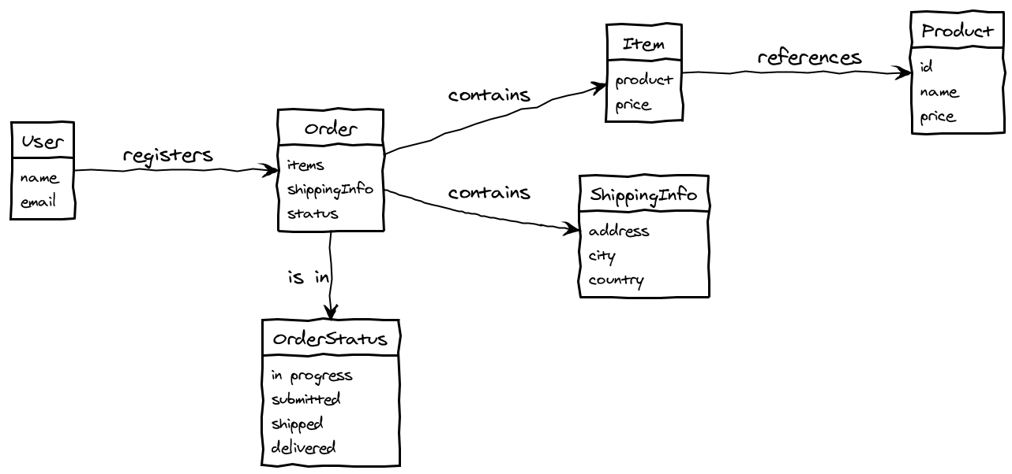

Slide 22

The physical data model
Data modelling is essential
Physical data model is technology-specific
Model and technology must fit
Data access patterns
Notes:
Most systems revolve around a certain system of record as the backbone for data storage and retrieval or even processing (this can be a database, a message bus, a cache – anything involving data manipulation).
As you understand better the fitness of a technology / architecture you will leverage a more fit data model. This physical data model is derived from the domain model and represents an organization of data into structures of data, tables, accounts and so on. This physical data model is technology-specific. In fact, it is optimized for the technology.
Depending on the use case, yes - you can leverage certain technologies and tools, but that's not everything. Data modelling is equally essential, as having the wrong data model used with the right technology can have undesired effects.
Technology choices are also informed by the data access patterns in the application(s). Your data access pattern will vary by use case:
- read intensive vs write intensive
- full scans vs random reads
- bulk writes vs fine grained writes
- individual record lookups vs window record aggregates
- incremental vs static

Slide 23
Data Management
Besides data modeling, data encoding also has an important role
In-memory (language-specific data structures)
Serialized/marshalled (JSON, BSON, XML, CSV, Protobuf, ...)
An important aspect for data encoding is schema evolution and how it can be handled with new and existing data
Schema-on-read vs. schema-on-write
Structured, semi-structured, unstructured data

Slide 24
Data Management
Other noteworthy capabilities that are important to consider for your system of record and data model:
Data access – the ability to access certain records or attributes of data
Data privacy – the process of enforcing regulatory acts upon stored data
Data repair – the process of performing edits upon stored data

Slide 25
Case study - Relational DB vs Document DB (interactive)
Design the data model for a system of record managing a travel blog .
Design the data model for a small warehouse.
Relational DB – data model
Document DB – data model
product
posts
{
"author":
"tags": [
]
"title":
"text":
}
{
"author":
"tags": [
]
"title":
"text":
}
{
"author": “MrBeast”
"tags": [
]
"title": “Giant Burgers”
"text": ”Come and get them”
}
product_type

Slide 26
Anything that can go wrong will go wrong.
Murphy’s First Law
Notes:
Murphy's Law: "Anything that can go wrong will go wrong", so you better prepare for it.

Slide 27
Embracing failure
Systems fail
Multiple failure dimensions
Traffic volume
Traffic patterns
External dependencies
Uncovered defects
Continuous improvement is key
Notes:
Ideally, a system once started, in perfect conditions, should perpetually serve its purpose, right?
In real life, it depends on various factors, such as:
traffic volume
traffic patterns
external dependencies
uncovered defects
Gall's Law: "All complex systems that work evolved from simpler systems that worked", so iterate.
Systems at scale
improbability almost becomes certitude
build-in fault tolerance and self-healing mechanisms
at the end of the day, you're limited by the current state of the art of technology

Slide 28

OREO (Operational Readiness ensures Efficient Operations)
Continuously improve services
Assume nothing
Employ pre-/post-mortems
Document operating procedures
Design with 10x scale in mind *
Notes:
Solutions need to ensure services are operationally ready by the time they are released to customers
We need to continuously improve the maturity of services throughout their life cycle
Assume nothing, take nothing for granted, be on-guard
Pre-mortem – envision what can go wrong and what are the consequences
Post-mortem – acknowledge failure and don't let it slip by, perform a root cause analysis (RCA) - take action items (improve operations/self-healing/fault tolerance)
Establish and document clear operating procedures as well as rules of engagement
Distinguish between cause and effect and what you're fixing
Be able to address certain 0-day exploits
Design with a 10x scale in mind (or at least pave the way for 10x)

Slide 29

Managing system limits
Success brings challenges
Enforce limits
Throttling at the API gateway level
Per-customer quotas (noisy neighbor problem)
DoS attacks
Notes:
As your service becomes more popular, you get more traffic from multiple customers. You shift more towards a more operational stage, as you encounter multiple system usage patterns.
You need to be careful not to become the victim of you own success.
Enforce limits, prevent system abuse. Just a few examples:
is your system intended for programmatic API usage?
if no, use CAPTCHA to prevent a DoS attack
throttling / customer quotas
allocate maximum quotas per tenant. If they get exceeded, you can make an informed decision which can be business related or technical related
DoS attacks are real and can have malicious impact on brands.

Slide 30
Case studies

Slide 31
Regarding system defects | Scenario
On your production environment, you notice that 2 out of 10 servers are overloaded, reaching close to 100% memory usage.
After some extensive troubleshooting, inspecting application logs and metrics you decide to restart the application on those 2 servers.
After restarting the application, everything is back to normal, and you sign off.
After several days, the problem reoccurs; you decide to manually restart the application once again. It works, so you don't pursue any other action items for you/the team.
Due to a customer upcoming event, for scalability reasons, you need to scale up to 100 servers. Now 25 out of 100 severs have the above-mentioned problem, recurrently.
Without knowing it, days pass and you “become part of the system”, meaning the application can’t pursue its normal intended function without you having to manually intervene.
This is TOIL work: manual, repetitive, devoid of actual value – work which is annoying at best and dangerous at worst
Notes:
TOIL work is dangerous for the company as usually one person (or a very limited number of persons) have the knowledge to quickly act upon it as well as the person, as morale decreases as you become a bottleneck.

Slide 32
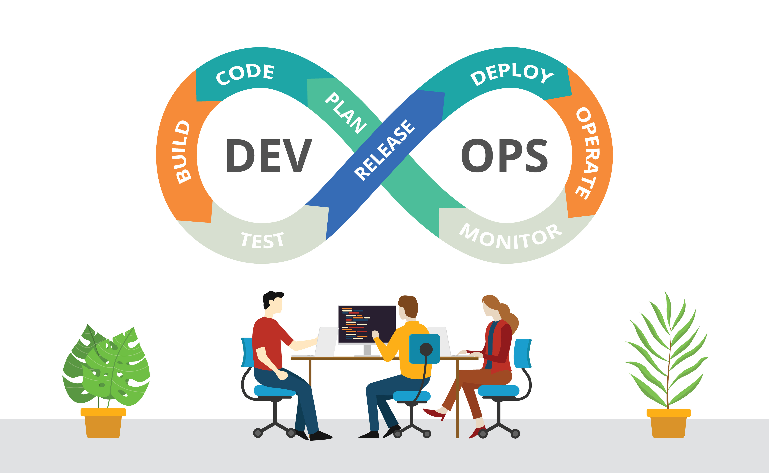
Regarding system defects | Approach
Distinguish between cause, effect and what you're fixing
known, resolvable issues – pursue fixes by addressing the cause (e.g. the application memory leak, not its effect)
unknown, resolvable issues – automate the fix and continue pursuing the cause until it becomes known
known, unresolvable issues – automate the fix and embrace failure OR redesign for better fault tolerance and self-healing
unknown, unresolvable – continue pursuing the cause until it becomes know; redesign?, but don’t give up
Understanding the building blocks is essential
Notes:
Know your dependencies / understand your building blocks
https://azure.microsoft.com/en-us/support/legal/sla/kubernetes-service/v1_1
https://aws.amazon.com/s3/sla
https://cloud.google.com/cdn/sla

Slide 33
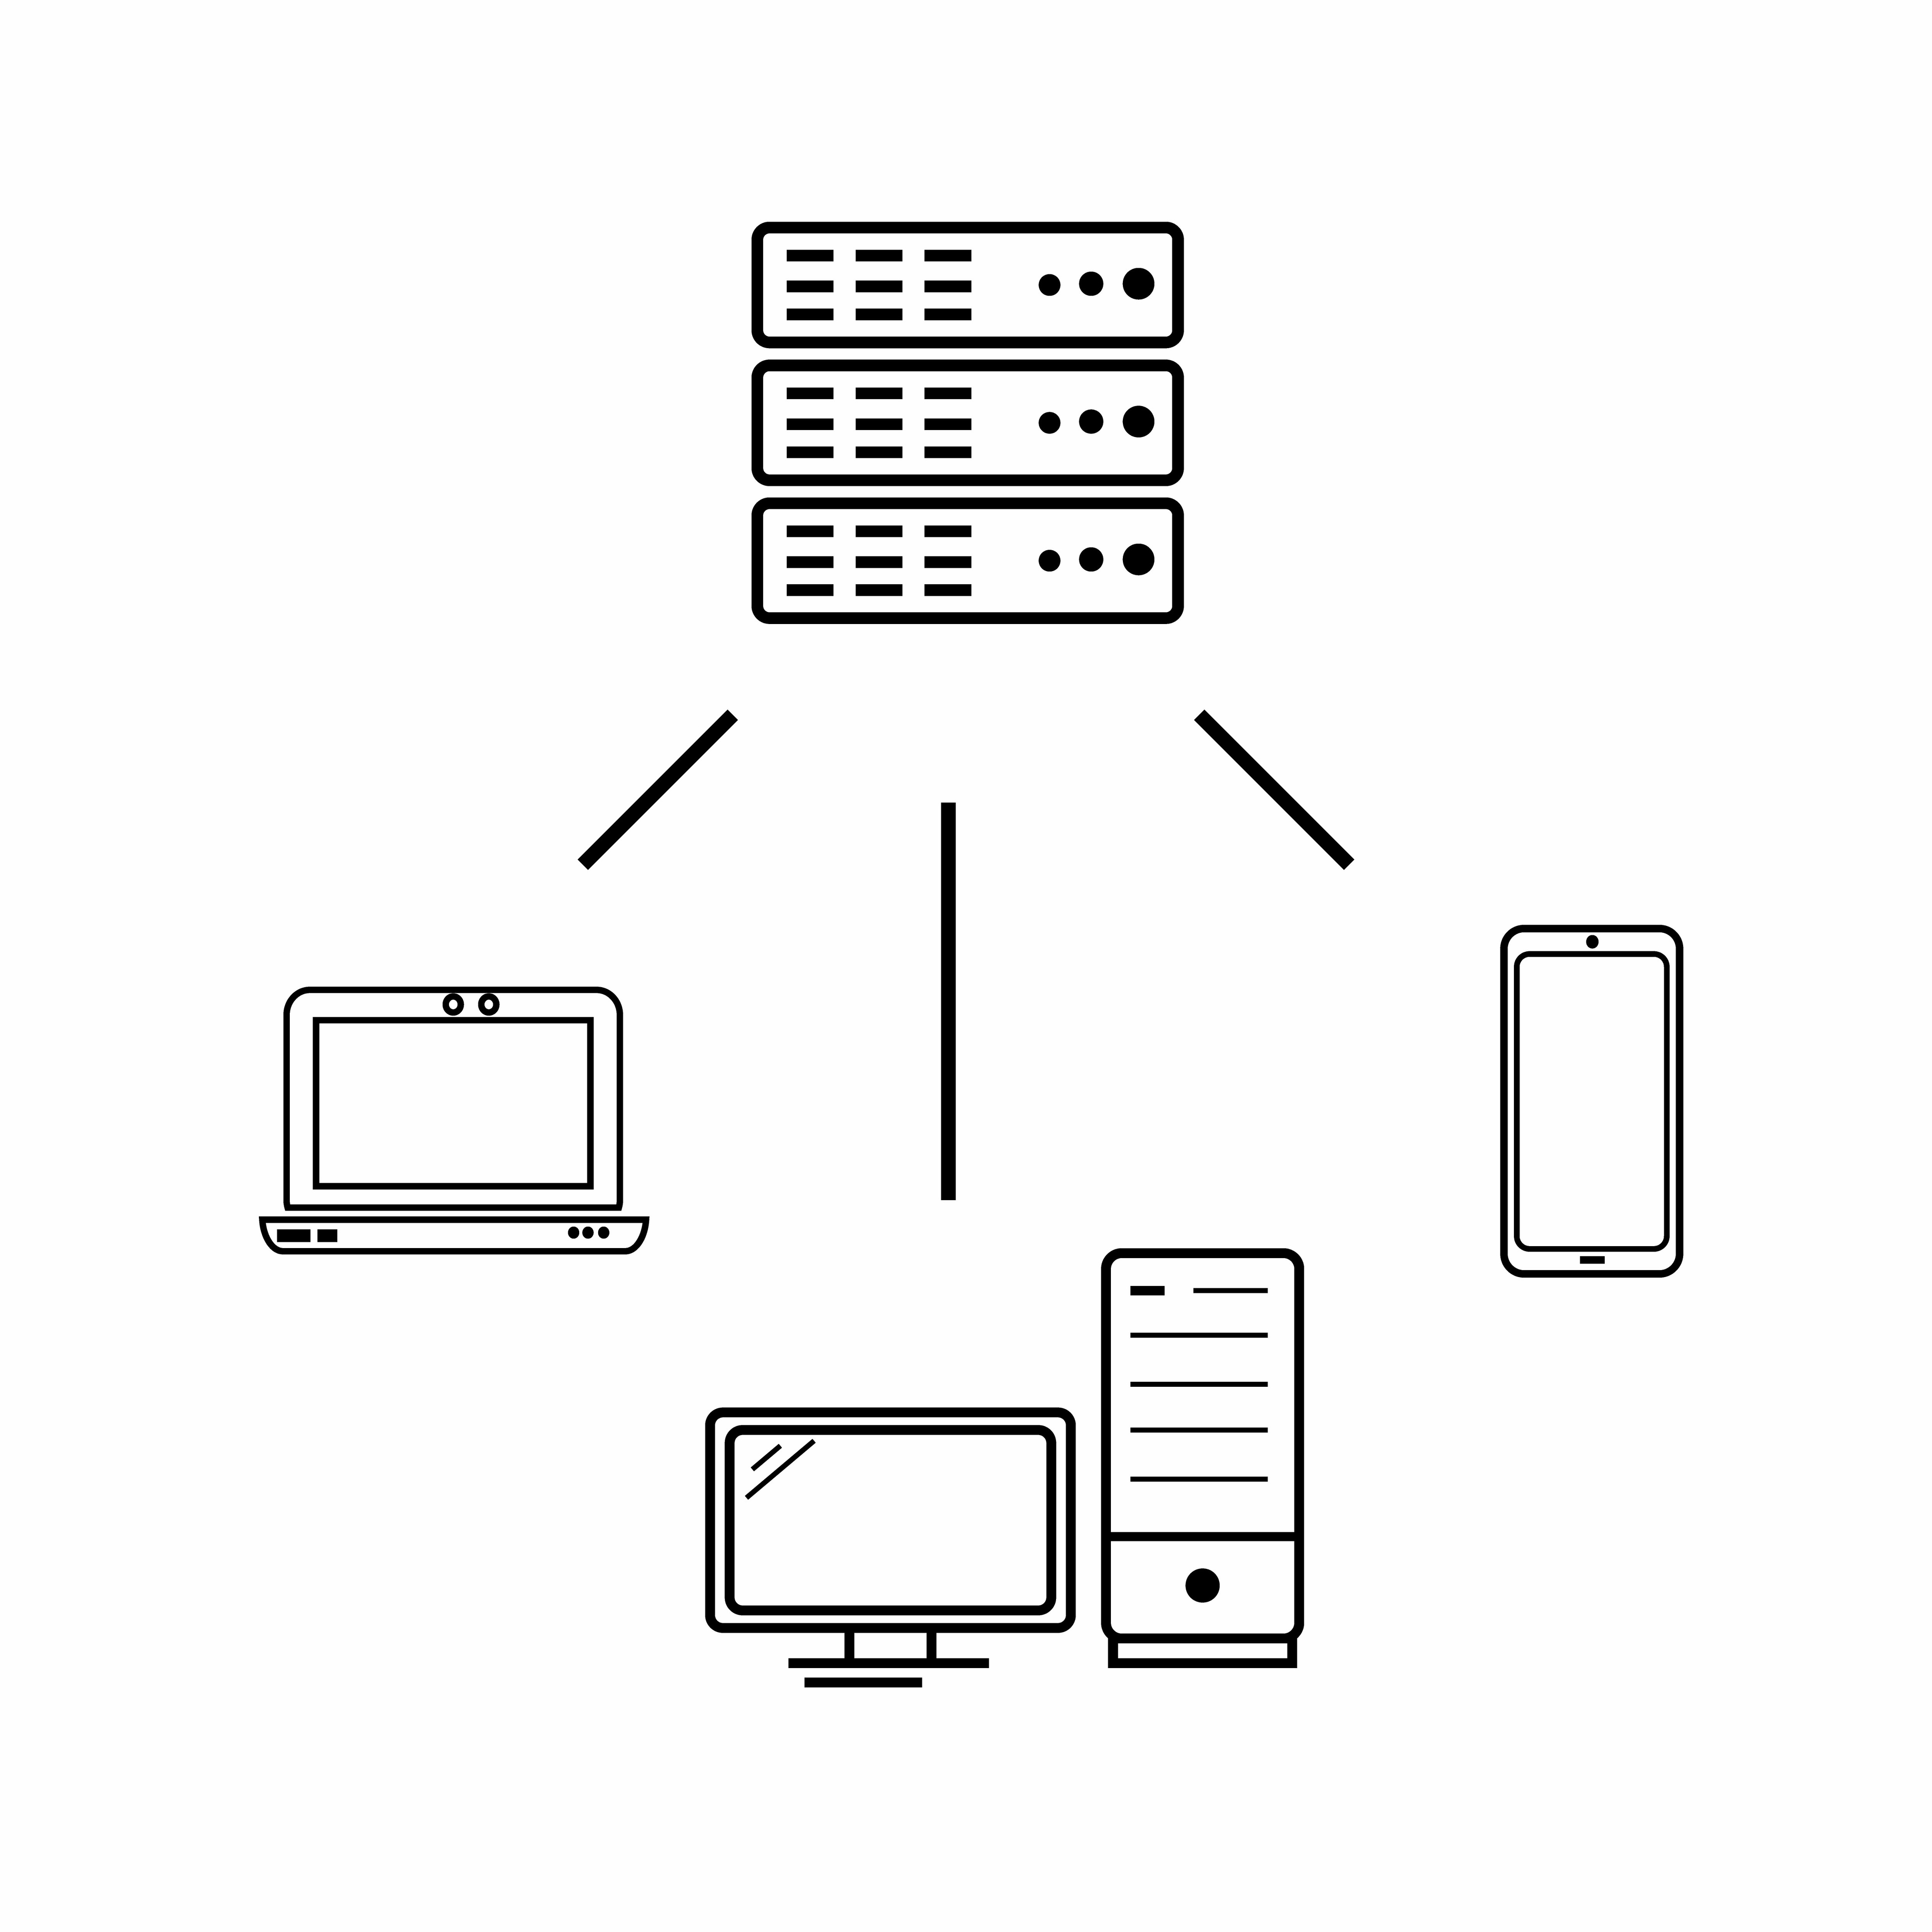
Future-proofing your system design | The innocent beginnings
A customer wants you to build a web app for them
You pursue a tightly coupled component approach with the app bundling both backend and frontend
The customer is so happy with the webapp, they want a native mobile application too, as the end-users want a more seamless and personalized experience
Now you either need to decouple the above or to implement a second stack

Slide 34
Future-proofing your system design | A better system design
A loosely coupled architecture could consist of
Backend application server exposing a REST API
Web UI calling the REST API
Mobile app calling the REST API
If the customer now wants to expose an API to only a few valuable customers
Implement the REST API in the backend server
Limits and access are managed centrally on the backend server
What did you learn from this?

Slide 35
Requirements’ impact on architecture | Low traffic scenario (A)
A generic web application, low traffic scenario:
Load: 10s of concurrent users / 100s of queries
Availability: 90% (< avg 3 days per month downtime)
Latency p99: <5 sec
Architecture:
Infrastructure: no LB, 1 app instance, 1 fixed small server
Tech stack: Python Django/Flask, SQLite, runs on a Raspberry Pi (under your desk)
Cost: < $100 / month
Operations: one-person-show / one aspirational student

Slide 36
Requirements’ impact on architecture | High traffic scenario (B)
Same generic web application, high traffic scenario (Scenario A × 100)
Load: 1Ks of concurrent users / 10Ks of queries
Availability: 99% (< avg 7.2 hours per month downtime)
Latency p99: <1 sec
Architecture:
Infrastructure: 1 LB, 10s of app instances, 5 fixed big servers
Tech stack: Java, Spring, MySQL, bare-metal servers (server room)
Cost: $1Ks / month
Operations: Ops/Sysadmin team (2-3 people)

Slide 37
Requirements’ impact on architecture | High availability scenario (C)
Same generic web application, high-availability traffic scenario (Scenario B × 100)
Load: 100Ks of concurrent users / 1Ms of queries
Availability: 99.99% (< avg 4.3minutes per month downtime)
Latency p99: <100ms
Architecture:
Infrastructure: 10s of LBs, 1k of app instances, 100s of elastic servers
Tech stack: Scala, nginx, Cassandra, Redis, k8s, cloud
Cost: $10Ks / month
Operations: SRE / Strong DevOps principles team
Notes:
Your system can be more reliable than its individual parts but can't be 100% bulletproof.

Slide 38
Requirements’ impact on architecture | High availability scenario (C)
Additional failure vectors:
DNS, cloud zone, ISP
Mitigation examples for mission-critical systems:
High-level DNS failover – active-active-active architecture
Zone fault-tolerance – multiple availability-zones deployment
Multi-cloud deployments
Notes:
Your system can be more reliable than its individual parts but can't be 100% bulletproof.

Slide 39
A few closing suggestions
Technologies come and go, focus on core concepts
Programming languages are mere tools for expression. You need the right tool for each job
Always challenge the current state of things. Go back to your initial and later added requirements. Refine them.
Don't pursue job security by not sharing knowledge with your peers.
Document things
Think twice before writing code. Do you need it?

Slide 40
A few closing suggestions, continued
Rewriting everything is usually a bad idea
Don’t just use frameworks blindly:
Nobody says to reinvent the wheel, but you should have the diligence to understand how and why the wheel spins.
Have a fail-fast approach, you don’t want your defects to be latent
Assume nothing, practice defensive coding
RTFM (read the freaking fine manual)

Slide 41
Questions?

Slide 42
References

Slide 43
Extracurricular lectures
Designing Data-Intensive Applications: The Big Ideas Behind Reliable, Scalable, and Maintainable Systems, by M. Kleppmann
Building Secure & Reliable Systems, by H. Adkins, B. Beyer, P. Blankinship, A. Oprea, P. Lewandowski, A. Stubblefield - https://sre.google/books/building-secure-reliable-systems/
Clean Architecture, by R. C. Martin
Fundamentals of Software Architecture, by N. Ford, M. Richards, P. Sadalage, Z. Dehghani
Software Architecture: The Hard Parts, by N. Ford, M. Richards, P. Sadalage, Z. Dehghani
The Missing Semester of Your CS Education - https://missing.csail.mit.edu

Slide 44
Software Engineering lore
https://www.bigocheatsheet.com
http://highscalability.com/numbers-everyone-should-know
https://en.wikipedia.org/wiki/Fallacies_of_distributed_computing
https://blog.developer.adobe.com/
https://netflixtechblog.com
https://jepsen.io/analyses
https://colin-scott.github.io/personal_website/research/interactive_latency.html
Notes:
Know your building blocks / be familiar with state of the art.
These are just a few examples, there are many other various specialized tech blogs and communities.

